Slide 1
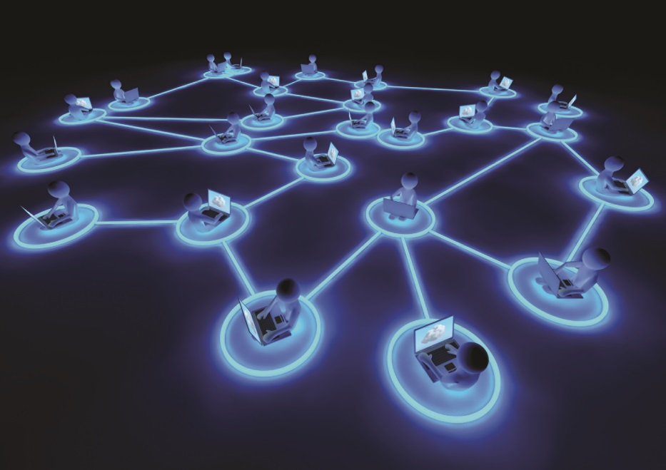
IT Essentials (CompTIA A+) Ch. 20
Essentials of Networking

Slide 2
Overview
In this chapter, you will learn how to:
Describe the basic roles of various networked computers
Discuss network technologies and Ethernet
Describe a typical Ethernet implementation

Slide 3
Roles Hosts Play in Networks
Host - Any computing device connected to a network
Web server - Stores and shares files that make up a Web site
Web browser - Asks Web server to share Web page files and displays them on the client
Server - Any computer that’s running a sharing program
Print server - Allows other networked computers to access the printer

Slide 4
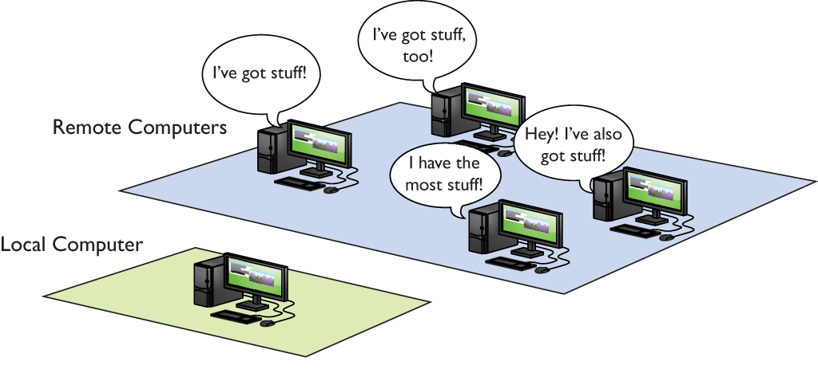
Roles Hosts Play in Networks
Figure 20.1 Accessing remote computers
Notes:
There are many good reasons to use a network, but what ties them together? In each of these situations, you are using your computer (the local computer) to access “stuff” stored on a remote computer (not your local computer). So what do other computers have that you might want (Figure 20.1)?

Slide 5
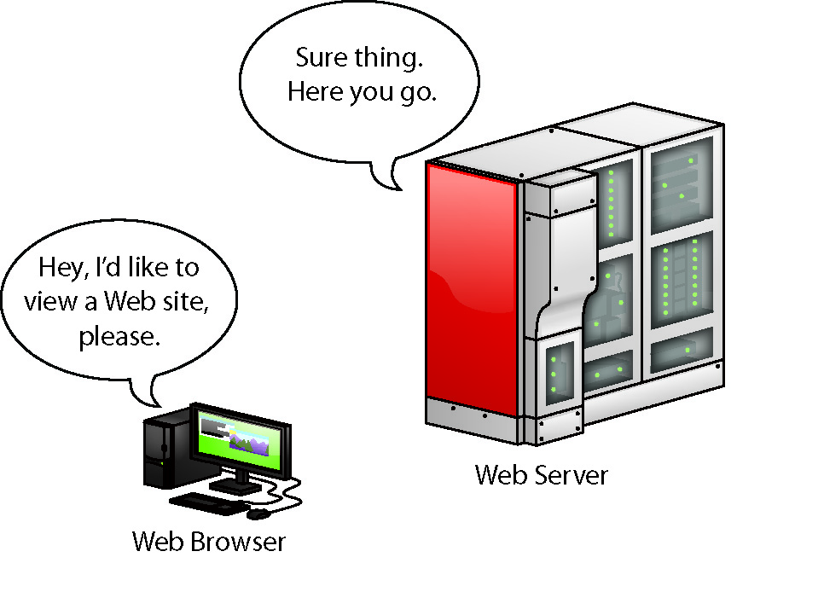
Roles Hosts Play in Networks
Figure 20.2 Accessing a Web page
Notes:
When you access a Web site, your Web browser (Internet Explorer, Mozilla Firefox, Google Chrome) asks the Web server to share the Web page files and then displays them (Figure 20.2).

Slide 6
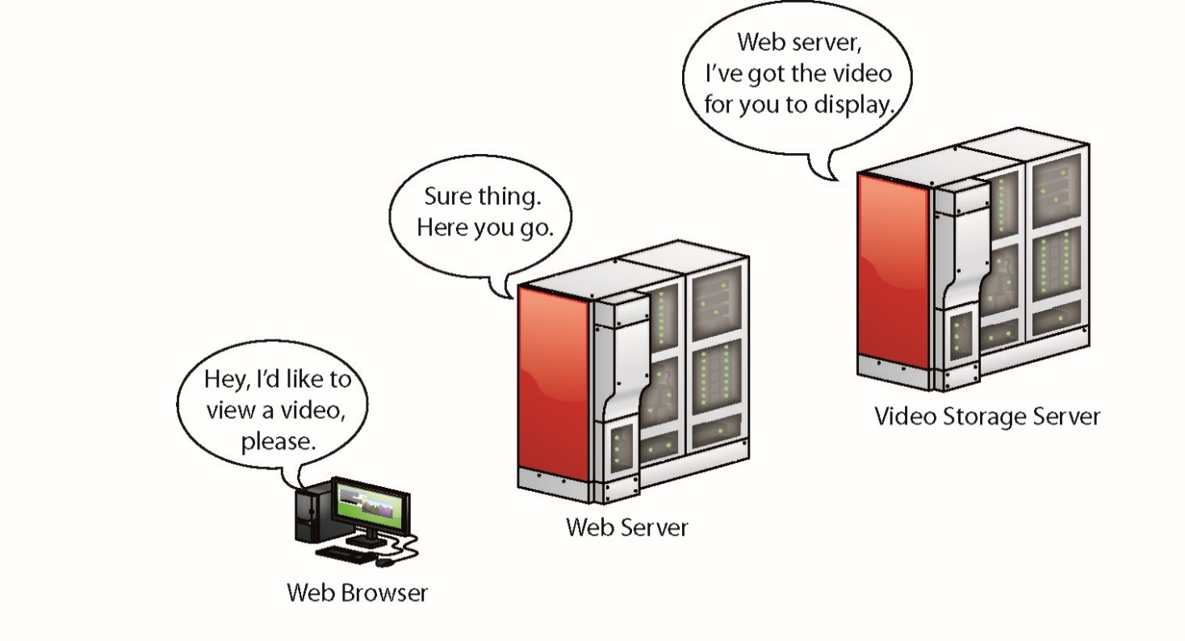
Roles Hosts Play in Networks
Figure 20.3 Accessing a YouTube page
Notes:
But what about YouTube? YouTube also uses Web servers, but these Web servers connect to massive video databases. Like a normal Web server, these remote computers share the videos with your client PC, but use special software capable of sending video fast enough so that you can watch it without waiting (Figure 20.3).

Slide 7
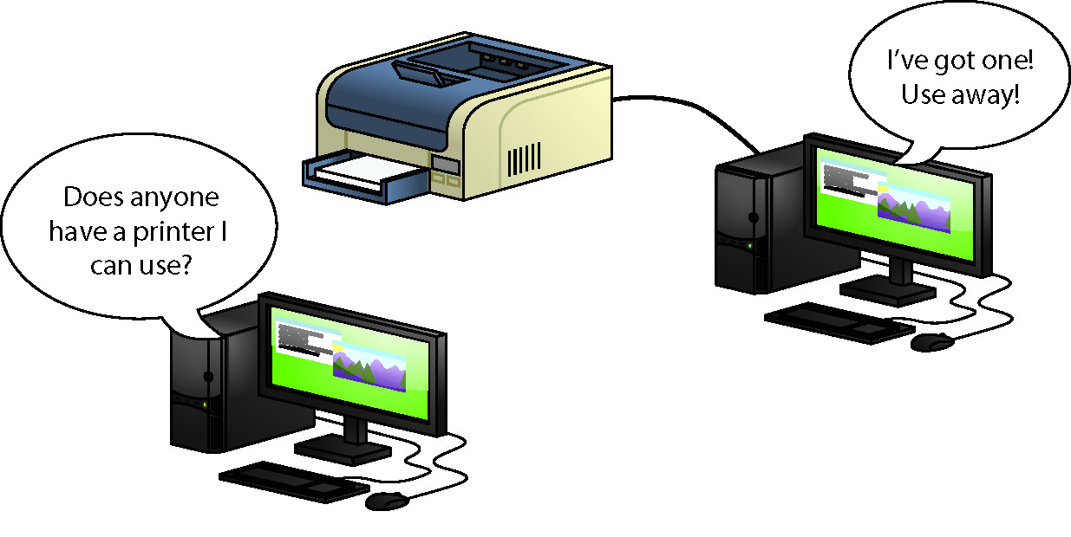
Roles Hosts Play in Networks
Figure 20.4 Sharing a printer in Windows
Notes:
We don’t need the Internet to share stuff. Figure 20.4 shows a small home network. One of the computers on the network has a printer connected via a USB port. This computer has enabled a printer-sharing program built into Windows so that the other computers on the network can use the printer.

Slide 8
Roles Hosts Play in Networks
File server
Networked host that enables access to files and folders
Mail server
Networked host used to access e-mail messages
Resource
Anything one computer might share with another

Slide 9
Roles Hosts Play in Networks
Network requirements for sharing and accessing resources
Something that standardizes the design and operation of cabling, network cards, and the interconnection of multiple computers
Addressing method to enable clients to find servers and enables servers to send data to clients
Method of sharing resources and accessing those shared resources

Slide 10
Networking Technologies
Network interface controller (NIC)
Needed by both clients and servers
Defines or labels the machine on the network
Breaks files into smaller units to send across network and reassembles them
Wire or wireless medium for delivering data units
Computer’s operating system communicating with networking hardware and other machines on the network
Notes:
Not too many years ago, every NIC came on an expansion card that you added to a motherboard. Most techs called that card a network interface card or NIC. Now that just about every motherboard has the networking feature built in, the acronym has shifted to network interface controller. You’re likely to see only the term NIC on the exams, though I call them network cards, too.

Slide 11
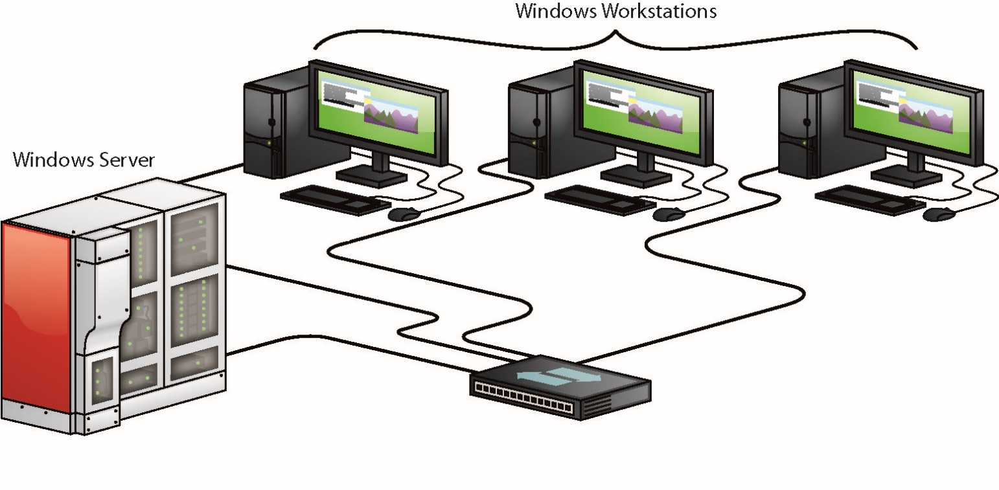
Networking Technologies
Figure 20.5 A typical network
Notes:
Your PC’s operating system has to be able to communicate with its own networking hardware and with other machines on the network. Figure 20.5 shows a typical network layout.

Slide 12
Frames and NICs
Data is moved from one PC to another in discrete chunks called frames.
All NICs have a built-in identifier, a binary address unique to that single network card.
Called a media access control (MAC) address
The MAC address is 48 bits long, providing more than 281 trillion MAC addresses.
MAC addresses are binary, but we represent them by using 12 hexadecimal characters.
MAC addresses are burned into every NIC.
Some NIC makers print the MAC address on the card.

Slide 13
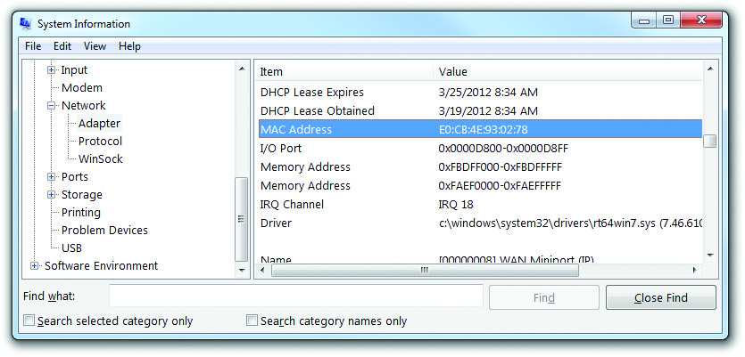
Frames and NICs
Figure 20.6 MAC address
Notes:
MAC addresses are burned into every NIC, and some NIC makers print the MAC address on the card. Figure 20.6 shows the System Information utility description of a NIC, with the MAC address highlighted.

Slide 14
Frames and NICs
Contents of a frame
MAC address of the network card to which the data is being sent
MAC address of the network card that sent the data
The data itself
Size varies depending on the type of frame.
A data check to verify that the data was received in good order
Most use a cyclic redundancy check (CRC).

Slide 15
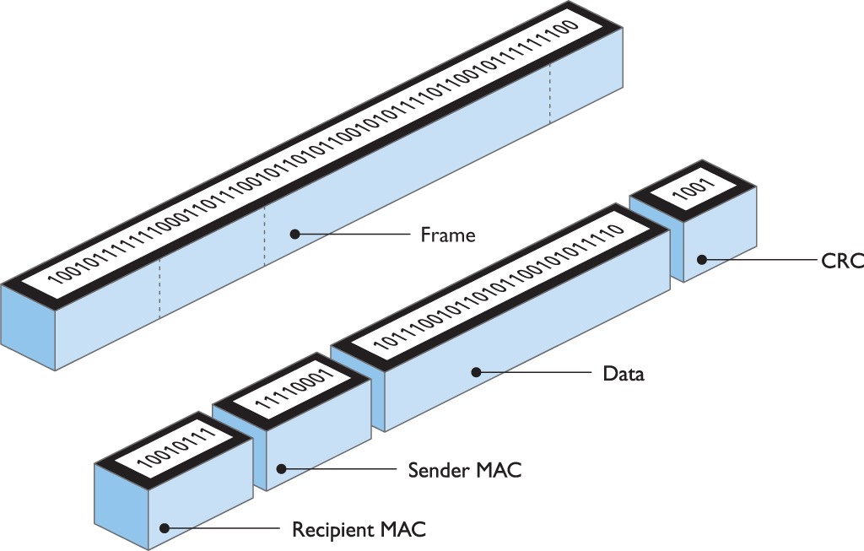
Frames and NICs
Figure 20.7 Generic frame

Slide 16
Ethernet
Digital equipment, Intel, and Xerox:
Invented the first network in the mid-1970s and created what eventually became the Ethernet standard
Ethernet is a series of standards for moving data from one computer to another.
Ethernet flavors are distinct improvements in areas such as speed, signaling, and cabling.
Ethernet frame has not changed—all flavors use the same frame type.

Slide 17
Ethernet
Modern Ethernet network speeds:
10BaseT (runs at 10 Mbps)
100BaseT (runs at 100 Mbps)
1000BaseT or Gigabit Internet (runs at 1000 Mbps, or 1 Gbps)
All three technologies—10/100/1000BaseT or Ethernet:
Use star bus topology
Connect via unshielded twisted pair (UTP) cabling

Slide 18
The Ethernet Star Bus
Each host connects to a central box called a switch.
The layout is called star bus topology.
PCs connect via special ports on switch.
Switches allow each port its own separate network.
The connection between a computer and a switch is a segment.
Segments limited to about 100 meters

Slide 19
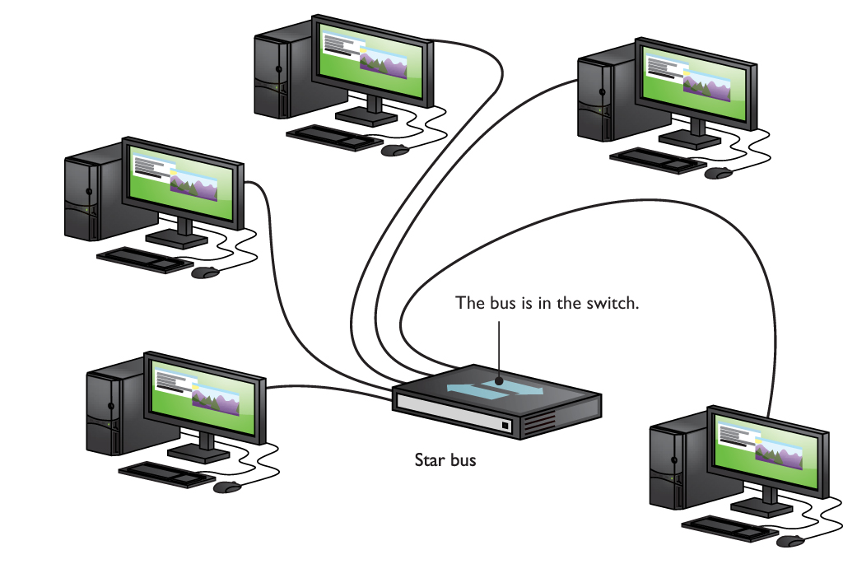
The Ethernet Star Bus
Figure 20.8 Ethernet star bus
Notes:
Imagine taking a bus network (where every computer connects to a common wire) and shrinking the bus down so it fits inside a box. Then, instead of attaching each PC directly to the wire, you attach them via cables to special ports on the box (Figure 20.8).

Slide 20
The Ethernet Star Bus
Early Ethernet networks used a hub.
Switch far superior and faster
Star bus topology doesn’t go down if a single cable breaks—but it does if the switch fails.

Slide 21
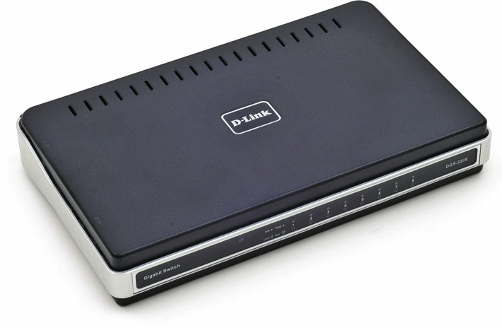
The Ethernet Star Bus
Figure 20.9 A switch
Notes:
A switch is a far superior and far more common version of a hub. Figure 20.9 shows a typical consumer-level switch.

Slide 22
Unshielded Twisted Pair (UTP)
UTP is the specified cabling for 10/100/1000BaseT and is the predominant cabling system today.
Many types are available for the needs of different networks.
Twisted pair cable involves AWG 22–26-gauge wire twisted together into color-coded pairs.
Each wire is individually insulated and encased as a group in a common jacket.

Slide 23
UTP
CAT Levels
UTP cables come in categories that define the maximum speed at which data can be transferred (bandwidth).

Slide 24
UTP
Table 20.1 |  | CAT Levels
CAT 1 | Standard telephone line
CAT 3 | Designed for 10-Mbps networks; a variant that used all four pairs of wires supported 100-Mbps speeds
CAT 5 | Designed for 100-Mbps networks
CAT 5e | Enhanced to handle 1000-Mbps networks
CAT 6 | Supports 1000-Mbps networks at 100-meter segments; 10-Gbps networks up to 55-meter segments
CAT 6a | Supports 10-Gbps networks at 100-meter segments
CAT 6e | A nonstandard term used by a few manufacturers for CAT 6 or CAT 6a
CAT 7 | Supports 10-Gbps networks at 100-meter segments; shielding for individual wire pairs reduces crosstalk and noise problems. CAT 7 is not a TIA/EIA standard
Notes:
There are CAT levels for connectors as well as cables. Don’t even try to use a CAT 5e RJ-45 connector with a CAT 6 cable.

Slide 25
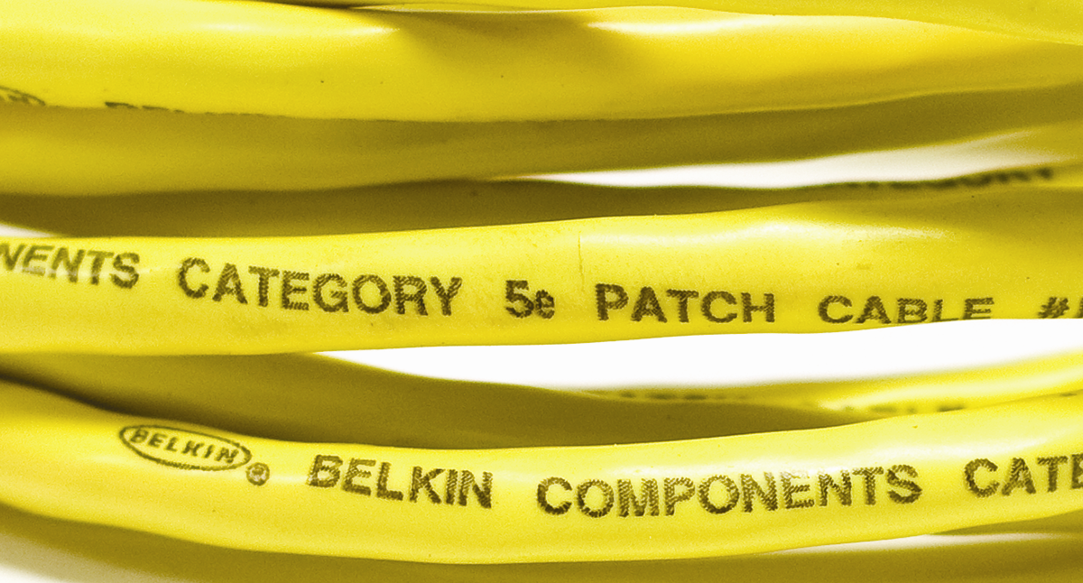
UTP
Figure 20.10 Cable markings for CAT level

Slide 26
Shielded Twisted Pair (STP)
Consists of twisted pairs of wires surrounded by shielding to protect them from electromagnetic interference (EMI)
Rare to see; used only in locations with excessive electronic noise such as shop floors

Slide 27
Ethernet with Twisted Pair
The 10BaseT and 100BaseT standards require two pairs of wires:
A pair for sending and a pair for receiving
10BaseT ran on an ancient CAT version called CAT 3, but typically used at least CAT 5 cable.
100BaseT requires at least CAT 5 to run.
1000BaseT needs all four pairs of wires in a CAT 5e or higher cable.
The RJ (registered jack) connector was invented by Ma Bell and is still used today.

Slide 28
Ethernet with Twisted Pair
Currently, only two types of RJ connectors are used for networking.
RJ-11 connects a telephone to a telephone jack in the wall of your house.
RJ-45 is the standard for UTP connectors, has connections for up to four pairs, and is visibly much wider than RJ-11.

Slide 29
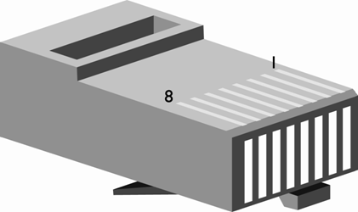
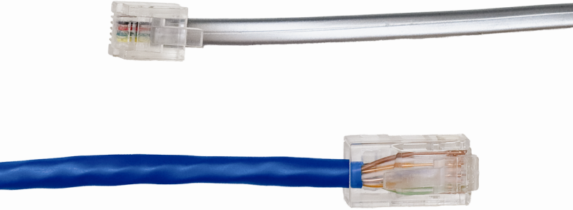
Ethernet with Twisted Pair
Figure 20.11 RJ-11 and RJ-45
Figure 20.12 RJ-45 pin numbers

Slide 30
Ethernet with Twisted Pair
TIA/EIA has two standards (both acceptable) for connecting the RJ-45 connector to the UTP cable:
TIA/EIA 568A (T568A)
TIA/EIA 568B (T568B)
UTP wires are color-coded with a standardized color and match to a particular pin (1–8) in the connector.
The TIA/EIA standards indicate which color is matched to each pin.
Notes:
Tech Tip: Plenum Versus PVC Cabling
The space in the ceiling, under the floors, and in the walls through which cable runs is called the plenum space.
Standard network cables usually use PVC (polyvinyl chloride) for the jacket, but PVC produces noxious fumes when burned. Plenum-grade cable is simply network cabling with a fire-retardant jacket and is required for cables that go in the plenum space.

Slide 31
Ethernet with Twisted Pair
Table 20.2 |  | UTP Cabling Color Chart
Pin | T568A |  | T568B | Pin | T568a | T568B
1 | White/Green |  | White/Orange | 5 | White/Blue | White/Blue
2 | Green |  | Orange | 6 | Orange | Green
3 | White/Orange |  | White/Green | 7 | White/Brown | White/Brown
4 | Blue |  | Blue | 8 | Brown | Brown
Notes:
The TIA/EIA has two standards for connecting the RJ-45 connector to the UTP cable: the TIA/EIA 568A (T568A) and the TIA/EIA 568B (T568B). Like all wires, the wires in UTP are numbered. A number does not appear on each wire, but rather each wire has a standardized color. Table 20.2 shows the official TIA/EIA Standard Color Chart for UTP.

Slide 32
Ethernet with Alternative Connections
Fiber optic cable uses light instead of electricity.
Signals travel 2000 meters or more.
Most fiber optic networks use 62.5/125 multimode fiber optic cable.
Two cables are required.
Common fiber optic connectors:
ST connector
SC connector
LC connector
Notes:
Tech Tip: Crossover Cables
You can hook two computers directly together using a special UTP cable called a crossover cable. A crossover cable is a standard UTP cable with one RJ-45 connector using the T568A standard and the other using the T568B standard. This reverses the signal between sending and receiving wires and thus does the job of a hub or switch. Crossover cables work great as a quick way to connect two computers directly for a quick and dirty network. You can purchase a crossover cable at any computer store.

Slide 33
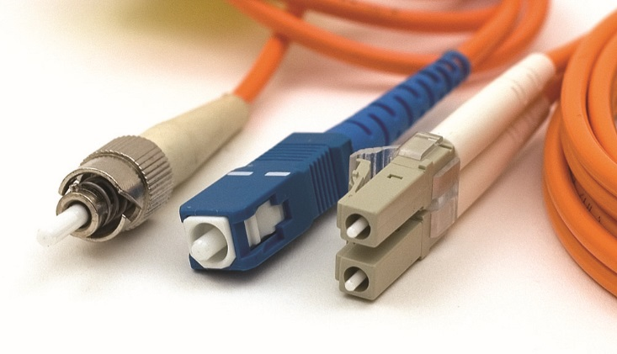
Ethernet with Alternative Connections
Figure 20.13 Typical fiber optic cables with ST, SC, and LC connectors

Slide 34
Ethernet with Alternative Connections
Multimode fiber optic cabling
Multimode fiber transmits multiple light signals at the same time.
Each signal uses different reflection angle within the core of the cable.
Single-mode fiber optic cable
It can be used with laser light to achieve high transfer rates over long distances.
Currently, it is rarely used except for long-distance links.

Slide 35
Ethernet with Alternative Connections
Coaxial cable
Used in early versions of Ethernet
Still used in cable modems and satellite connections
Consists of a center cable (core) surrounded by insulation and covered with shield of braided cable
Rated using an RG name
Two covered on CompTIA A+ exam: RG-59 and RG-6
Standards rated by impedance, measured in ohms
Both RG-59 and RG-6 have 75 ohm impedance

Slide 36
Ethernet with Alternative Connections
Connectors for coaxial cable
BNC connector – uncommon
F-type connector – on the back of all cable modems and most televisions
Notes:
BNC stands for different things, depending on who you ask. The two most common interpretations are Bayonet Neill-Concelman or British Naval connector. Just say “BNC” and network people will know what you mean.

Slide 37
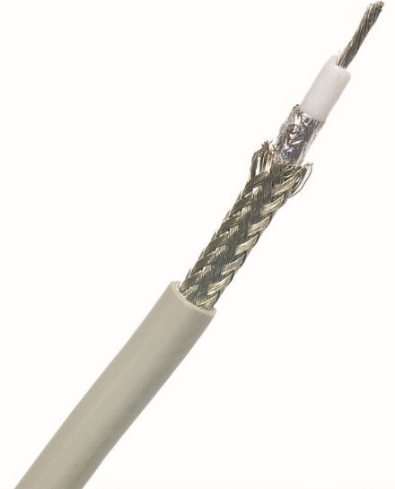
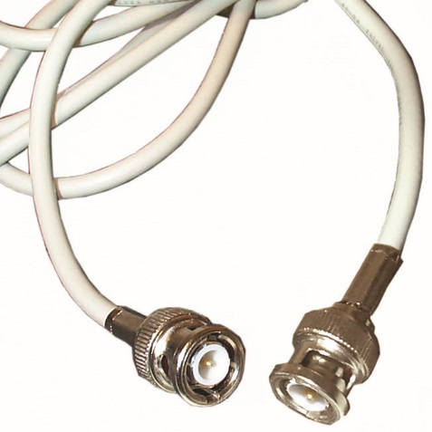
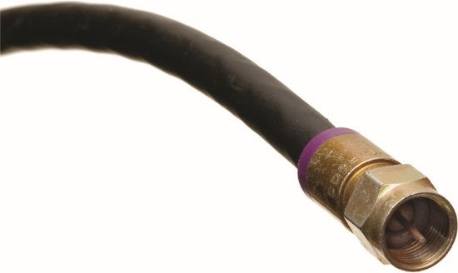
Ethernet with Alternative Connections
Figure 20.14 Typical coax
Figure 20.15 BNC connector
Figure 20.16 F-type connector

Slide 38
Implementing Ethernet
Local area network (LAN)
Group of computers are located physically close to one another.
Located in a single room, floor, or building
Able to hear each other when one sends a broadcast
Broadcast domain
Group of computers are connected by one or more switches.
All nodes receive broadcasts from all other nodes.

Slide 39
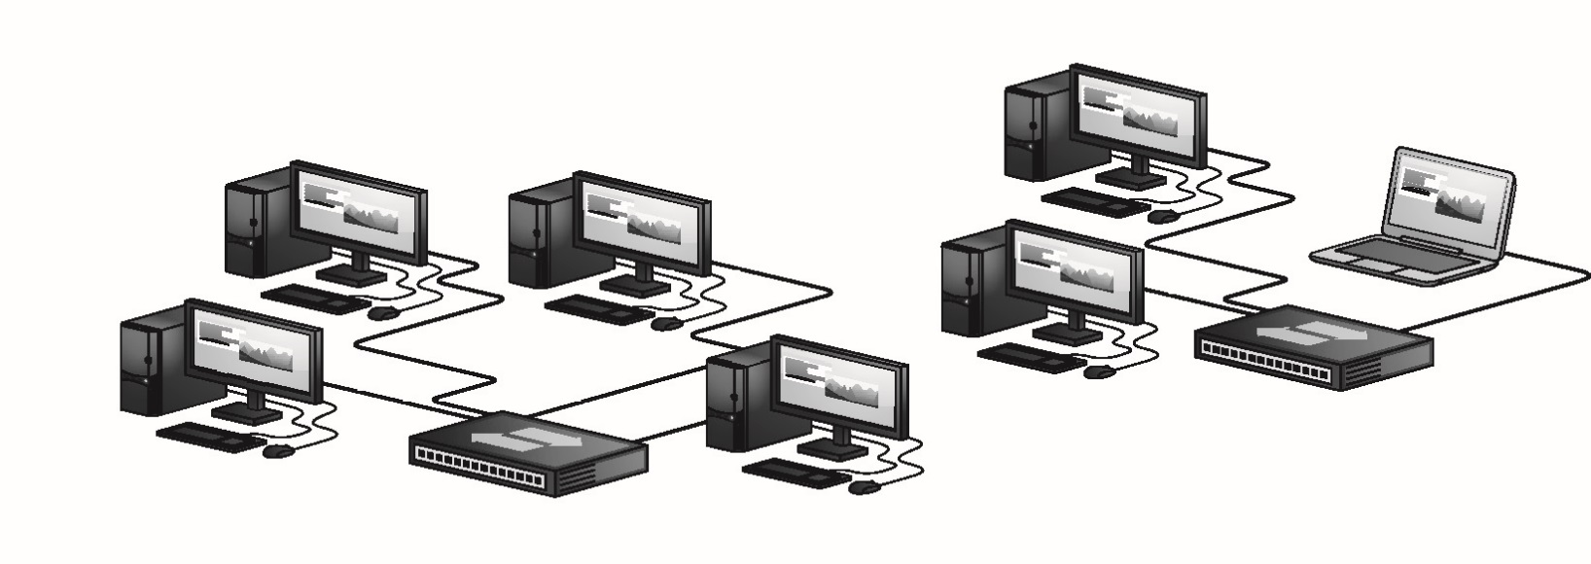
Implementing Ethernet
Figure 20.17 Two broadcast domains—two separate LANs

Slide 40
Implementing Ethernet
Ethernet over Power uses the existing electrical network in the building for connectivity.
Specialized bridges that connect to power outlets
Fastest versions at 100 Mbps
Useful if you have a place wireless won’t work and traditional cables can’t reach
A bridge is a device that connects dissimilar network technologies that transmit the same signal.

Slide 41
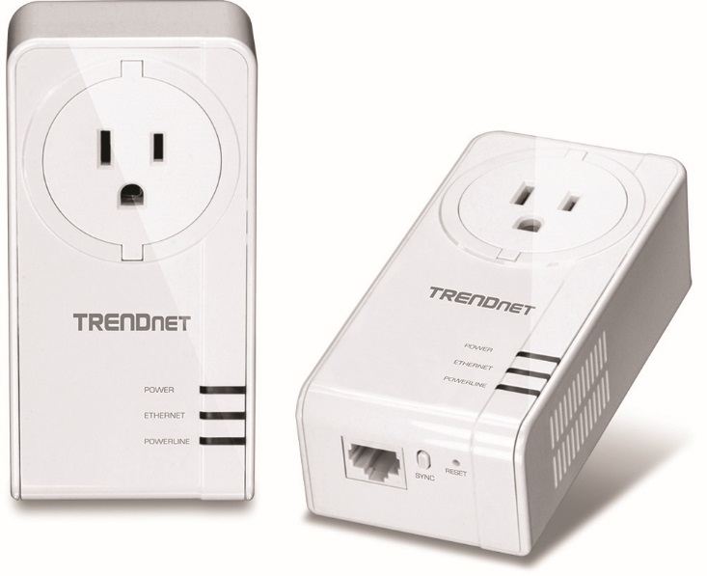
Implementing Ethernet
Figure 20.18 Ethernet over Power bridge

Slide 42
Structured Cabling
Standards defined by the TIA/EIA
Goal of structured cabling
To create safe, reliable infrastructure for all interconnected devices
Problems with running cabling across the floor
Creates a trip hazard
Damages cables over time
Results in electrical interference

Slide 43
Structured Cabling
Essential components of a structured cabling network
Telecommunications room
All cables concentrate in this area.
Horizontal cabling
A single piece of horizontally-installed cabling is called a run.
Work area
Office or cubicle containing a workstation and a telephone

Slide 44
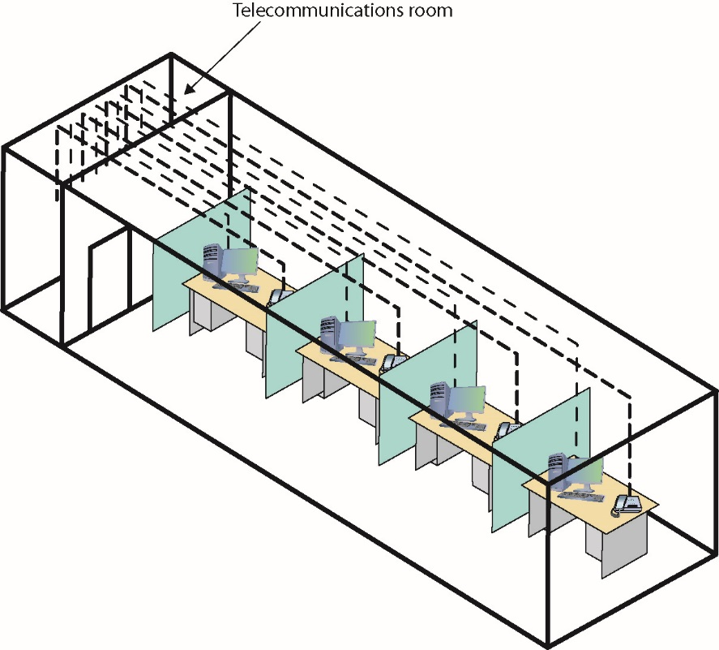
Structured Cabling
Figure 20.20 Telecommunications room

Slide 45
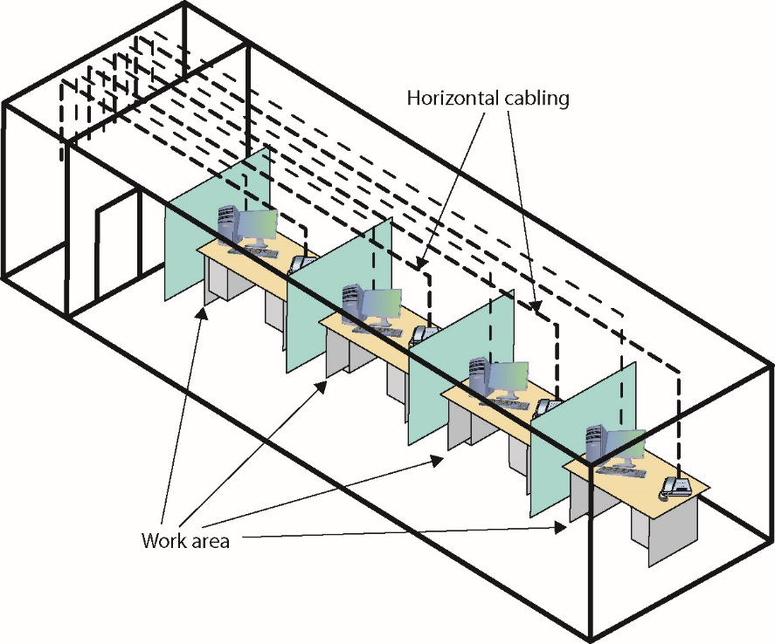
Structured Cabling
Figure 20.21 Horizontal cabling and work areas

Slide 46
Structured Cabling
Horizontal cabling
Traverses more or less horizontally from work area to the telecommunications room
Cat 5e or better UTP in most networks
Solid core versus stranded core
Solid core UTP uses a single solid wire.
Better conductor, but stiff and fragile
Specified by TIA for horizontal cabling
Stranded core is characterized by each wire comprised of a bundle of tiny wire strands.
Stands up to handling without breaking

Slide 47
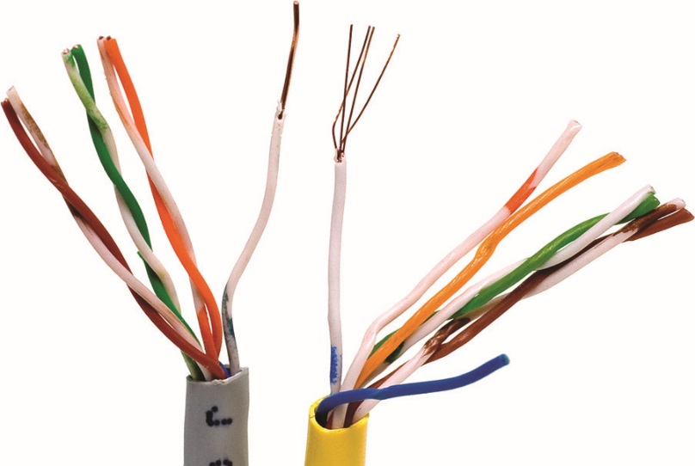
Horizontal Cabling
Figure 20.22 Solid and stranded core UTP

Slide 48
The Telecommunications Room
Networks change over time.
Need to impose some organization
Equipment rack provides a safe, stable platform to hold hardware components.
19 inches wide
Height varies
Height measurement known as a U (1.75 inches)
Most hardware 1U, 2U, or 4U
Hardware mounted with screws

Slide 49
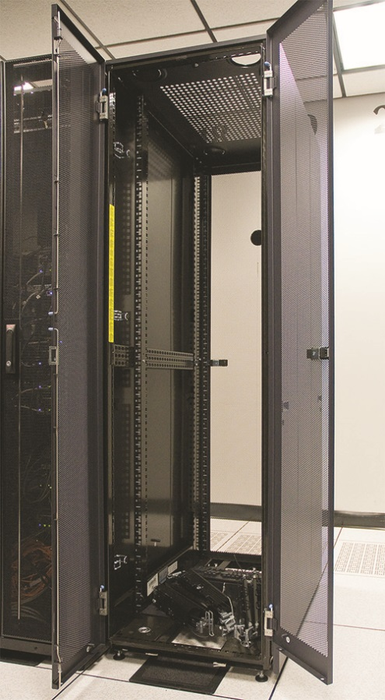
The Telecommunications Room
Figure 20.24 A floor-to-ceiling rack

Slide 50
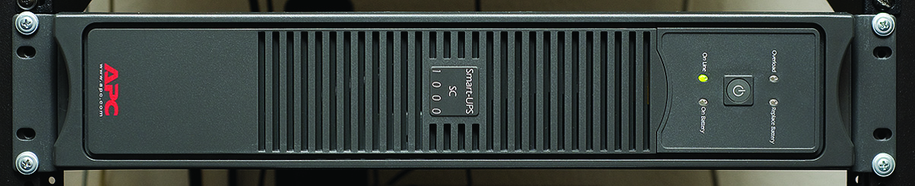
The Telecommunications Room
Figure 20.25 A rack-mounted UPS

Slide 51
The Telecommunications Room
Patch panel
Box with female connectors (ports) in front and permanent connections in the back
Horizontal cables connect in back.
110 block
Special type of connector used on the most common type of patch panel
UTP connects using a punchdown tool.

Slide 52
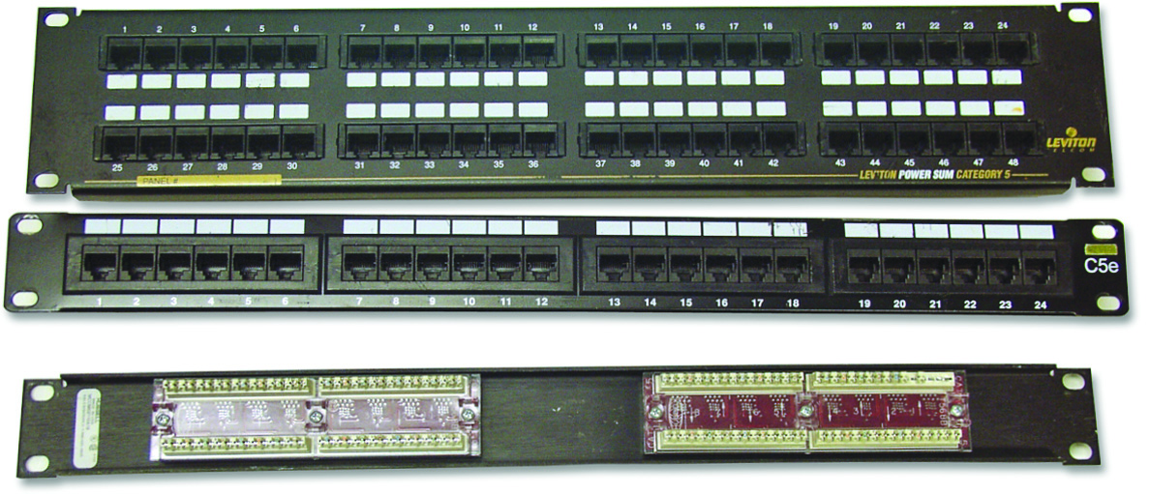
The Telecommunications Room
Figure 20.26 Typical patch panels

Slide 53
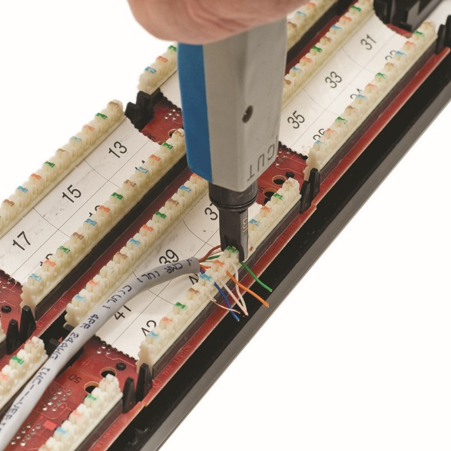
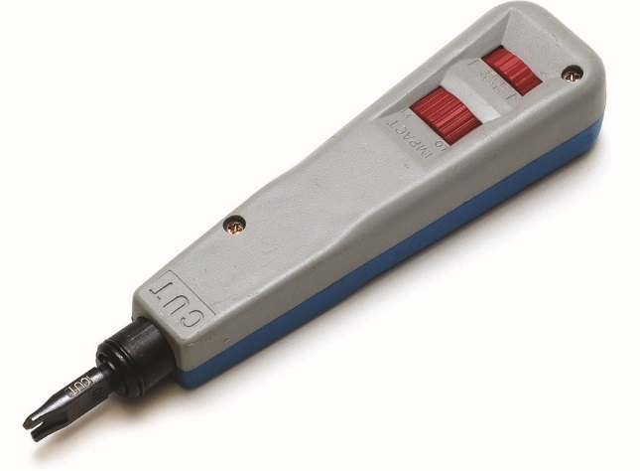
The Telecommunications Room
Figure 20.27 Punchdown tool
Figure 20.28 Punching down a 110 block

Slide 54
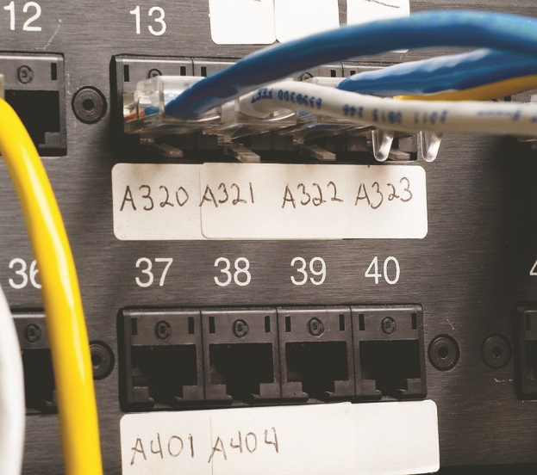
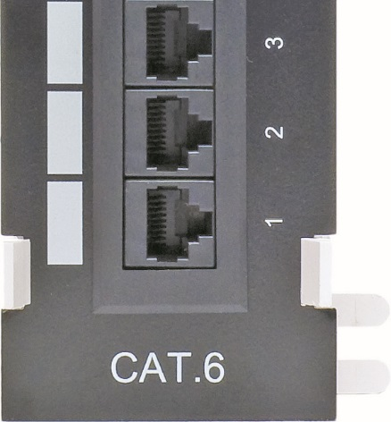
The Telecommunications Room
Figure 20.29 Typical patch panels with labels
Figure 20.30 CAT level on patch panel

Slide 55
The Telecommunications Room
Label your patch panels.
Use own internal code
Can use TIA/EIA 606 labeling methodology
Patch panels come with CAT ratings.
Patch cables are short cables that connect the ports to the switch.
Typically two to five feet long
Use stranded cable

Slide 56
The Telecommunications Room
Can purchase premade patch cables or make your own
Rolling your own patch cables
Use stranded cable that matches CAT level of horizontal cabling.
Tools: RJ-45 crimper and wire snips
Notes:
The CompTIA A+ exams expect you to know that a cable tech uses a crimper or crimping tool to attach an RJ-45 to the end of a UTP cable.

Slide 57
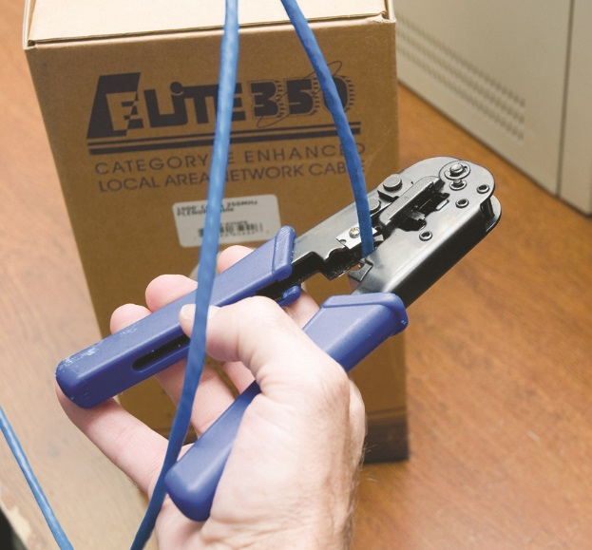
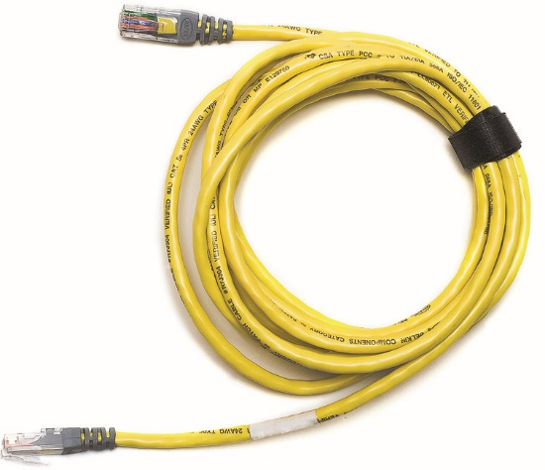
The Telecommunications Room
Figure 20.31 Typical patch cable
Figure 20.32 Crimper and snips

Slide 58
The Telecommunications Room
Steps for properly crimping an RJ-45 onto a UTP cable
Cut the cable square.
Strip off one-half inch of plastic jacket from end of cable.
Insert each individual wire into the correct location according to either TIA/EIA 568A or B.
Insert the crimp into the crimper and press.
Add a boot.
Test it using a cable tester.

Slide 59
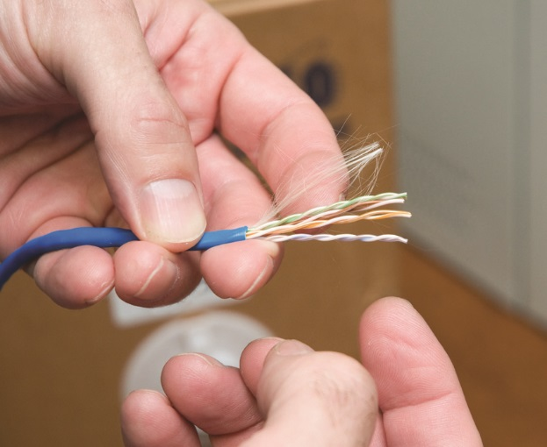
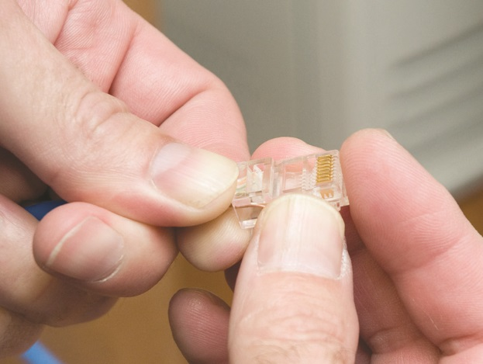
The Telecommunications Room
Figure 20.33 Properly stripped cable
Figure 20.34 Inserting the individual strands

Slide 60
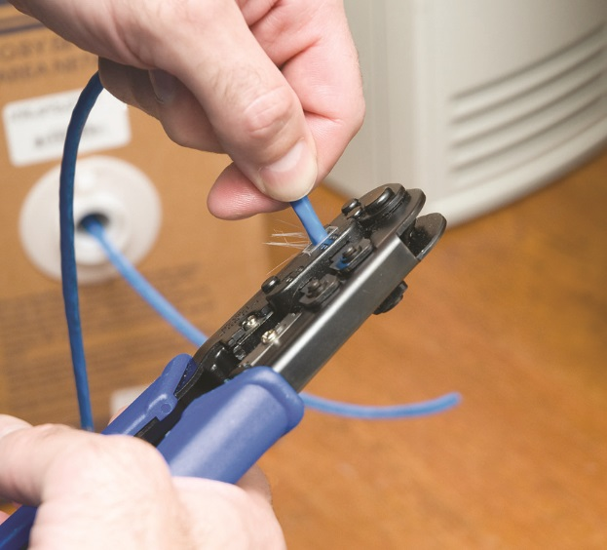
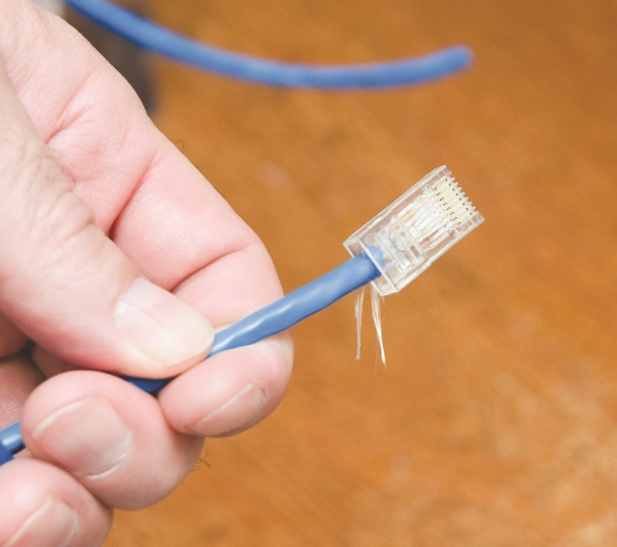
The Telecommunications Room
Figure 20.35 Crimping the cable
Figure 20.36 Properly crimped cable

Slide 61
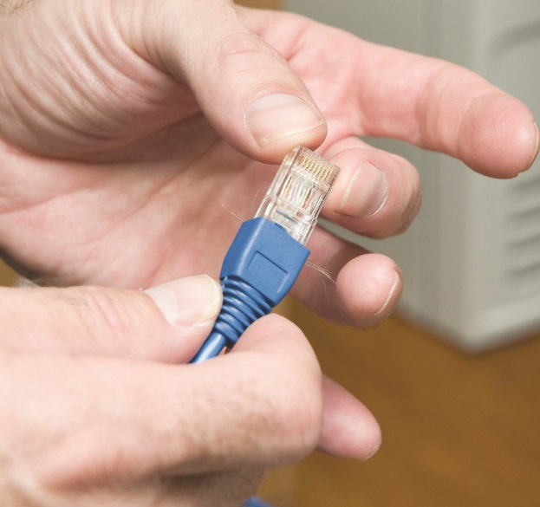
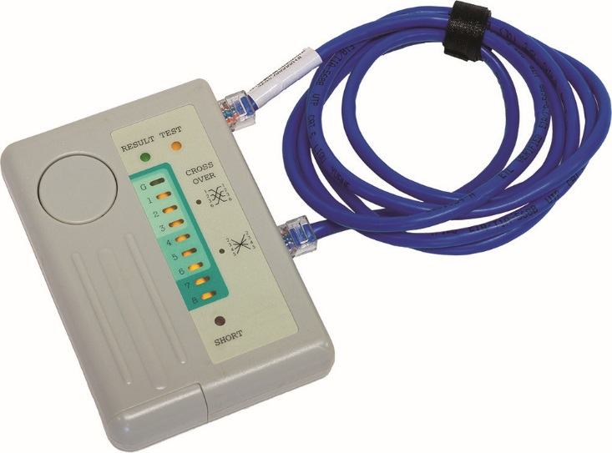
The Telecommunications Room
Figure 20.37 Adding a boot
Figure 20.38 Typical tester

Slide 62
The Work Area
Work area is a wall outlet.
Termination point for horizontal network cables
One or two female jacks to accept the cable
Mounting bracket and faceplate
Workstation connects to wall outlet using a patch cable.
Female RJ-45 jacks in wall outlets have CAT ratings.
Match network cabling CAT rating
Notes:
The work area may be the simplest part of the structured cabling system, but it is also the source of most network failures. When a user can’t access the network and you suspect a broken cable, the first place to look is the work area.

Slide 63
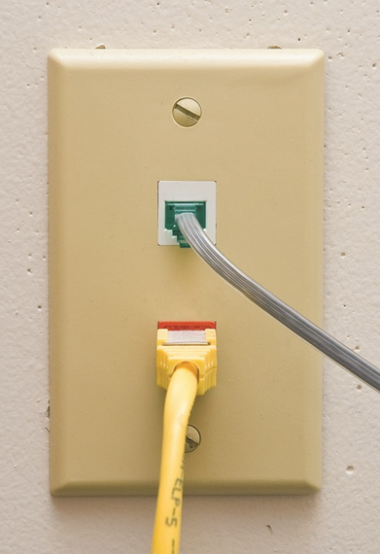
The Work Area
Figure 20.39 Typical work area outlet

Slide 64
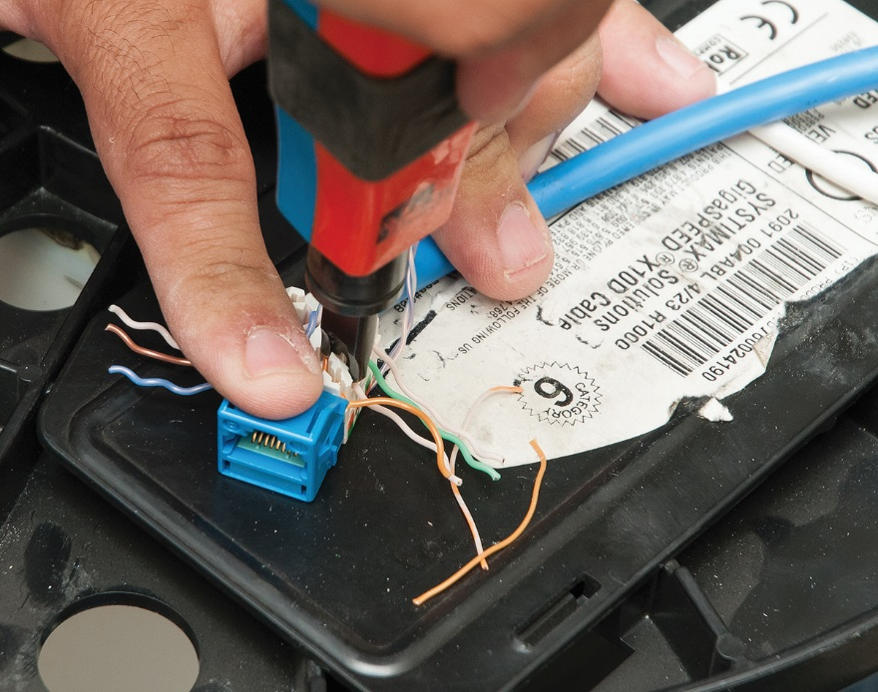
The Work Area
Figure 20.40 Punching down a modular jack

Slide 65
Going Wide
Wide area network (WAN)
Widespread group of computers connected using long-distance technologies
Router
A router connects LANs into a WAN.
Sorts the frames and sends them to the proper LAN
Routers destroy any incoming broadcast frames.
Going beyond a LAN requires a network protocol, typically TCP/IP.

Slide 66


Slide 67
Summary
Describe the basic roles of various networked computers
Discuss network technologies and Ethernet
Describe a typical Ethernet implementation

Slide 68


